Slide 1
MMT (Multi Meshed Tree) Protocols for Cognitive Airborne Networks
Nirmala Shenoy
Lab for Wireless Networking and Security
Rochester Institute of Technology

Slide 2
Typical MANET scenario
AN comprises of heterogeneous subnetworks (UAV networks, ground troops…) that are located at distances geographically.
Subnets have different missions and the traffic to /from subnets are highly unbalanced
Backbone Gateway Nodes
REQUIRED
Good connectivity within subnets
Good connectivity among subnets
REQUIRED
High connectivity, service specific traffic handling
REQUIRED
No orphan nodes, service specific traffic handling
UAV subnet
Command &Control
Backbone
Global Information Grid
Backbone of loitering / orbiting nodes with multiple connect points to subnets,
Handoff as nodes or subnets move.
Tactical subnet1
Tactical subnet2
Focus Connectivity
Reliable Data Delivery
Subnets are mission specific, vary in applications, devices, communication patterns, services, mobility patterns, speeds
Ref: USAF Airborne Network Special Interest Group, HQ/ESC/NI1, “Airborne Network Architecture, System Communications Description and Technical Architecture Profile, v1.1”, 7 October 2004.

Slide 3
Airborne Networks Challenges
Among others
Connectivity
Reliability in data transfer
Handling and scheduling unbalanced traffic demands
Scalability
Evolvability (IPv4 IPv6 …… ?)
Airborne Network is a large scale (Mobile Ad Hoc Network) MANET

Slide 4
MANET Challenges and Solutions
Challenge
Solution
Scalability
Low overheads
Robust connectivity
Robust Routes
Evolvability
Logical clustering
Hybrid routing (proactive and reactive)
Avoid message flooding
Dynamic routes with non stale backup
Reduce dependency on the number of forwarding nodes
IP (layer 3) transparent/layer 2 adaptable
The Multi Meshed Tree (MMT) algorithm supports all above features

Slide 5
The Multi Meshed Tree Algorithm

Slide 6
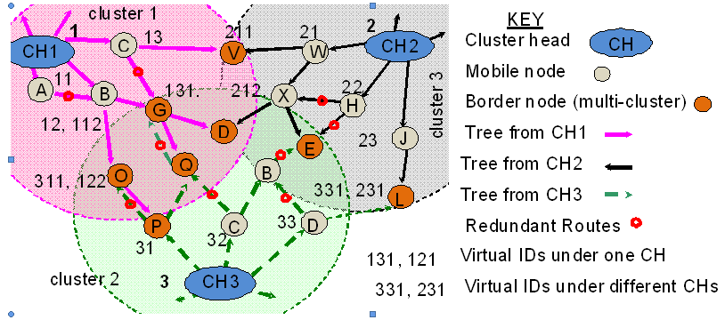
MMT Operation (The Mesh and Tree!)
Multi Hop - Cluster Formation and Proactive Route Setup
Proactive Route Setup does NOT Flood Messages
Route Information Contained in VIDs – NO Routing Tables, States

Slide 7
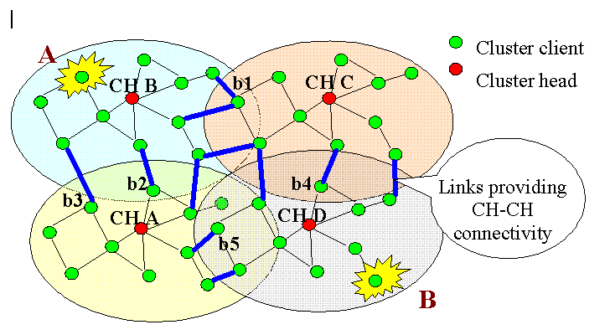
MMT Reactive Routing
Route discovery – A to B
A forwards route discovery message to CH B.
CH B forwards the message to border nodes b1, b2.
b1 forwards to CH C, CH C forwards to b4.
b2 forwards to CH A., CH A forwards to b5.
b4 and b5 forward to CH D, CH D forwards to B.
Route Discovery Messages are NOT Flooded
* Route record maintained at A (CH B, CH C and CH D) or
(CH B, CH A and CH D)
* Recorded route dependency on cluster heads only
Reduced Probability of Route Failure
* Routes are concatenation of proactive routes
Notes:
This picture explains the reactive route discovery process, where A tries to discover a route to B. The routing protocol does not flood the network, but address the discovery messages to the clusterheads and borders nodes (cluster heads have knowledge of the border nodes)

Slide 8
MMT Protocols in Airborne Network
AFRL Rome NY

Slide 9
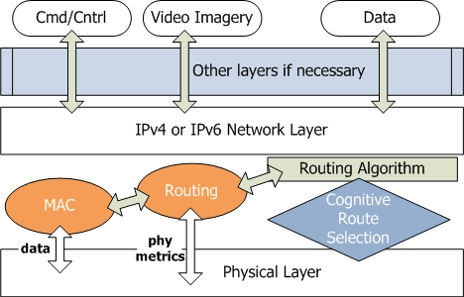
The Cross Layered Cognitive Approach
Diffserv Code point
(Service Quality handling)
Layer 3
Layer 2
Layer 1
Routing and forwarding done using VIDs, no need for 2 addresses

Slide 10
Directional Antenna Networks
Airborne nodes with directional antennas
Time Division Multiple Access
Synchronization
Locations
Distributed scheduling
Synchronous time slot allocation
Asynchronous time slot allocation
Simultaneous transmissions can be scheduled
Ground Troops – omni directional antennas
Loosely scheduled
Ultra Wide Band

